Slide 1
Bayesian Network Session 09
Course : COMP6065001 Artificial Intelligence
Effective Period : September 2023

Slide 2
Learning Outcomes
At the end of this session, students will be able to:
LO 3: Apply various techniques to an agent when acting under certainty

Slide 3
Outline
Representing Knowledge in an Uncertain Domain
Semantic of Bayesian Networks
Efficient Representation of Conditional Distribution
Exact Inference in Bayesian Networks
Exercise

Slide 4
Representing Knowledge in an Uncertain Domain
A Bayesian network is a directed graph that represents the dependencies among variables and any full joint probability distribution
Each node corresponds to a random variable
A set of directed arrows connects pairs of nodes
Direct influence
Each node has a conditional probability distribution
P (X_{i} | Parents(X_{i}))

Slide 5
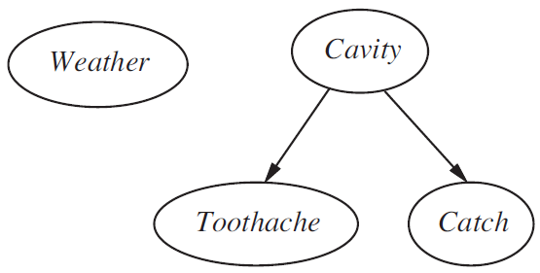
Representing Knowledge in an Uncertain Domain
Example
Weather is independent of the other variables
Toothache and Catch are conditionally independent given Cavity
A Simple Bayesian Network

Slide 6
Representing Knowledge in an Uncertain Domain
Example (A new burglar alarm)
An alarm responds to (almost) a burglary and (sometimes) a minor earthquake
There are two neighbours (John and Mary) who always call you when they hear an alarm
John always calls when he hear alarm or mistakenly hear telephone ring
Mary often misses the alarm because she likes hearing loud music
Draw the Bayesian network!

Slide 7
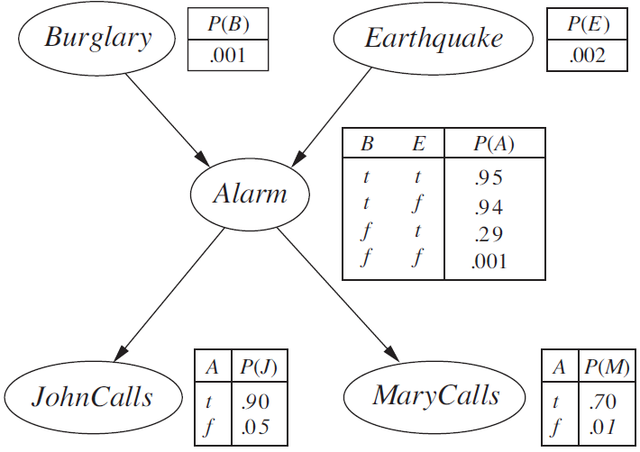
Representing Knowledge in an Uncertain Domain
A Typical Bayesian Network

Slide 8
Representing Knowledge in an Uncertain Domain
The conditional distributions are shown as a conditional probability table (CPT)
CPT contains the conditional probability of each node value for a conditioning case
A possible combination of values for the parent nodes

Slide 9
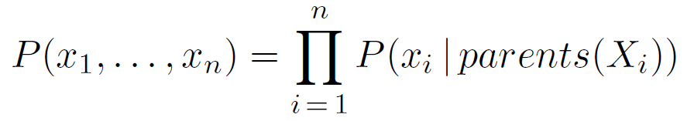

Semantic of Bayesian Networks
The full joint distribution is defined as the product of the local conditional distributions:
What is the probability of an alarm ring but neither a burglary nor an earthquake has occurred, and both John and Mary call?

Slide 10
Semantic of Bayesian Networks
Solve it, the answer is = 0,000628

Slide 11
Semantic of Bayesian Networks
A method for constructing Bayesian networks
Nodes: Determine the set of variables to model the domain {X_{i},…,X_{n}}
Links: For i =1 to n, do:
Choose the parents for X_{i}
For each parent, insert a link from the parent to X_{i}
CPTs: Write down the conditional probability table

Slide 12
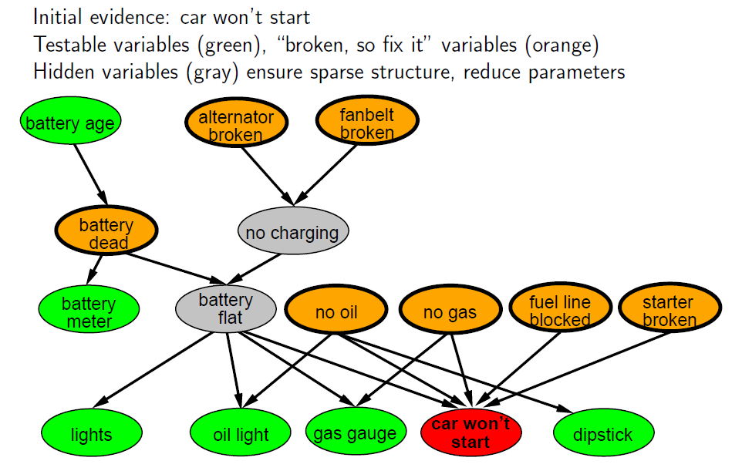
Example

Slide 13
Efficient Representation of Conditional Distribution
We can represent the conditional distribution in more efficient way by utilizing deterministic nodes (no uncertainty)
It has its value specified exactly by the values of its parents
I.e. The relationship between the parent nodes Canadian, US, Mexican and the child node NorthAmerican is simply that the child is the disjunction of the parents

Slide 14
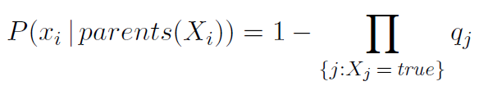
Efficient Representation of Conditional Distribution
From individual probabilities, the entire CPT can be built
qcold = P(¬fever | cold, ¬flu, ¬malaria) = 0.6
qflu = P(¬fever | ¬cold, flu, ¬malaria) = 0.2
qmalaria = P(¬fever | ¬cold, ¬flu, malaria) = 0.1
With the general rule is

Slide 15
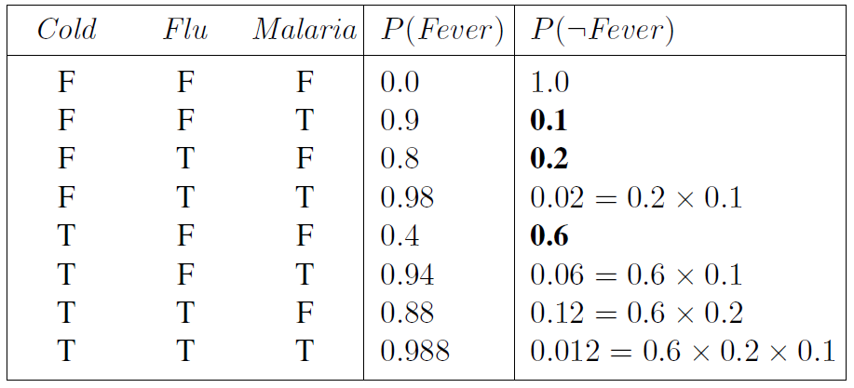
Efficient Representation of Conditional Distribution

Slide 16
Exact Inference in Bayesian Networks
The basic task for any probabilistic inference system is to compute the posterior probability for a set of query variables, given some observed event
In the burglary, we might observe the event in which JohnCalls = true and MaryCalls = true

Slide 17


Exact Inference in Bayesian Networks
Inference by enumeration
A query can be answered using
Query P(Bulgary | JohnCalls = true, MaryCalls = true)

Slide 18


Exact Inference in Bayesian Networks
Inference by enumeration
For Bulgary = true
P(b) is constant, moved outside the summations:

Slide 19
Exact Inference in Bayesian Networks
Inference by enumeration

Slide 20
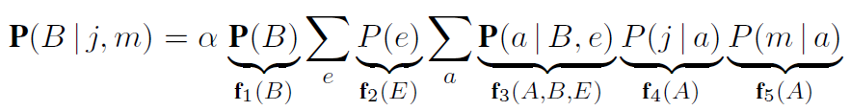
Exact Inference in Bayesian Networks
The variable elimination algorithm
To eliminate repeated calculation in enumeration process
Let’s apply this to burglary network

Slide 21

Exact Inference in Bayesian Networks
The variable elimination algorithm
To eliminate repeated calculation in enumeration process
Note, that we apply each expression with a factor (f). In f₄ and f₅, the depending variable is A, so

Slide 22
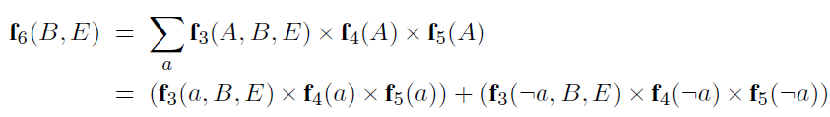

Exact Inference in Bayesian Networks
The process of evaluation is a process of summing out variables (right to left) from pointwise products of factors to produce new factors. The steps are follows:
First, we sum out A from the product of f₃, f₄, and f₅
Now we are left with the expression

Slide 23
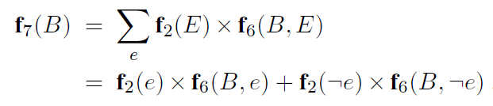

Exact Inference in Bayesian Networks
Next, we sum out E from the product of f₂ and f₆
This leaves the expression

Slide 24
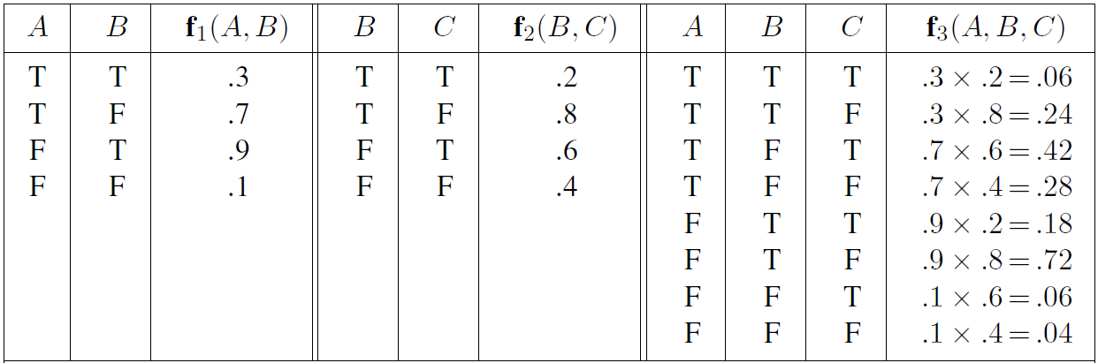
Exact Inference in Bayesian Networks
Operation on factors
Illustrating pointwise multiplication between factors

Slide 25
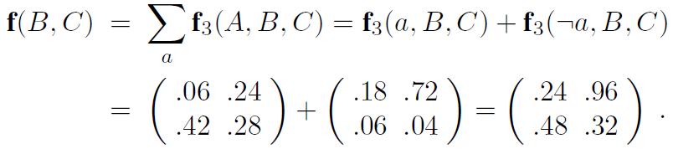
Exact Inference in Bayesian Networks
Summing out a variable, from a product of factors is done by adding up the submatrices formed by fixing the variable

Slide 26
Exercise

Slide 27
Case Study
Bayesian Network
As Enrichment Program is a mandatory program for every student in Bina Nusantara University, a survey is done to determine the student interest in Research Track, one of the tracks that could be chosen in Enrichment Program, and the correlation with the students’ background. In general, the probability of a student is a Computer Science student is 25%. Then, the probability of a student is a Female is 40%. There is also other observations, as follow:
The probability of a Computer Science student is a Female taking interest in AI is 20%
The probability of a Computer Science student is a Male taking interest in Ai is 30%
The probability of a non-Computer Science student is a Female taking interest in AI is 0%
The probability of a non-Computer Science student is a Male taking interest in AI is 40%
Then, the probability of a student taking interest in AI to enroll in Research Track is 50%. There is another case, where the probability of a student enrolling in Research Track without taking interest in AI is 10%.
Question:
Calculate the probability of a student taking Research Track is a Female!

Slide 28
References
Stuart Russell, Peter Norvig. 2010. Artificial Intelligence : A Modern Approach. Pearson Education. New Jersey. ISBN:9780132071482

